Slide 1
Semaphore

Slide 2
POSIX Semaphores
Data type
Semaphore is a variable of type sem_t
Include <semaphore.h>
Atomic Operations
int sem_init(sem_t *sem, int pshared, unsigned value);
int sem_destroy(sem_t *sem);
int sem_post(sem_t *sem);
int sem_trywait(sem_t *sem);
int sem_wait(sem_t *sem);

Slide 3
Unnamed Semaphores
#include <semaphore.h>
int sem_init(sem_t *sem, int pshared, unsigned value);
Initialize an unnamed semaphore
Returns
0 on success
-1 on failure, sets errno
Parameters
sem:
Target semaphore
pshared:
0: only threads of the creating process can use the semaphore
Non-0: other processes can use the semaphore
value:
Initial value of the semaphore
You cannot make a copy of a semaphore variable!!!

Slide 4
Semaphore Operations
#include <semaphore.h>
int sem_destroy(sem_t *sem);
Destroy an semaphore
Returns
0 on success
-1 on failure, sets errno
Parameters
sem:
Target semaphore
Notes
Can destroy a sem_t only once
Destroying a destroyed semaphore gives undefined results
Destroying a semaphore on which a thread is blocked gives undefined results

Slide 5
Semaphore Operations
#include <semaphore.h>
int sem_post(sem_t *sem);
Unlock a semaphore
Returns
0 on success
-1 on failure, sets errno (== EINVAL if semaphore doesn’t exist)
Parameters
sem:
Target semaphore
sem > 0: no threads were blocked on this semaphore, the semaphore value is incremented
sem == 0: one blocked thread will be allowed to run
Notes
sem_post() is reentrant with respect to signals and may be invoked from a signal-catching function

Slide 6
Semaphore Operations
#include <semaphore.h>
int sem_wait(sem_t *sem);
Lock a semaphore
Blocks if semaphore value is zero
Returns
0 on success
-1 on failure, sets errno (== EINTR if interrupted by a signal)
Parameters
sem:
Target semaphore
sem > 0: thread acquires lock
sem == 0: thread blocks

Slide 7
Semaphore Operations
#include <semaphore.h>
int sem_trywait(sem_t *sem);
Test a semaphore’s current condition
Does not block
Returns
0 on success
-1 on failure, sets errno (== AGAIN if semaphore already locked)
Parameters
sem:
Target semaphore
sem > 0: thread acquires lock
sem == 0: thread returns

Slide 8
Introduction to Pthreads

Slide 9
Using Posix Thread Library
To use this library, #include <pthread.h> in your program.
To compile, link with the pthread library:
gcc hello.c -o hello –lpthread

Slide 10
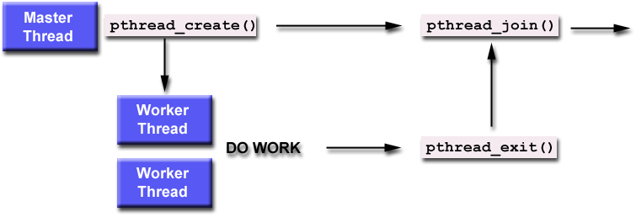
Thread Lifecycle – joinable thread
similar to waitpid(), calling thread blocks
thread attributes specified
status returned
Thread Termination
returns from its starting routing (main program)
call pthread_exit
cancelled by another thread pthread_cancel
process terminated

Slide 11
Basic Thread Functions 1/6
pthread_create function
#include <pthread.h>
int pthread_create (pthread_t * tid, const pthread_attr_t *attr, void *(*func) (void*), void *arg);
//Returns 0 if OK, positive Exxx value on error
When a program is started, single thread is created (main thread). Create more threads by calling pthread_create()
pthread_t is often an unsigned int. returns the new thread ID
attr: is the new thread attributes: priority, initial stack size, daemon thread or not. To get default attributes, pass as NULL
func: address of a function to execute when the thread starts
arg: pointer to argument to function (for multiple arguments, package into a structure and pass address of structure to function)

Slide 12
Basic Thread Functions 3/6
pthread_join function
#include <pthread.h>
int pthread_join (pthread_t tid, void ** status);
//Returns 0 if OK, positive Exxx value on error
Wait for a given thread to terminate (similar to waitpid() for Unix processes)
Must specify thread ID (tid) of thread to wait for
If status argument non-null
Return value from thread (pointer to some object) is pointed to by status

